Slide 1

Malicious URL Analysis Tool
Adham Ansari(22BCE8873)
Kshitij Pathak(22BCE20232)

Slide 2
Introduction
The URL Analysis Tool is designed to assess the security of a given URL by checking it against multiple security databases, analyzing domain and IP details, and identifying potential threats. This project integrates various APIs, including Google Safe Browsing, VirusTotal, and IOC Search, to provide comprehensive security evaluations.
Why URL Security Matters
With the increasing threat of phishing attacks, malware distribution, and malicious redirections, it is crucial to verify URLs before interacting with them. Many users unknowingly click on harmful links, leading to data breaches or system infections. This tool aims to mitigate such risks by providing an automated URL analysis mechanism.

Slide 3
Objective
Detect malicious URLs using threat intelligence APIs.
Extract and analyze domain details, including IP addresses and DNS records.
Verify domain age and check for suspicious patterns.
Provide a user-friendly interface for URL analysis.
Assist cybersecurity professionals and everyday users in identifying threats proactively.

Slide 4
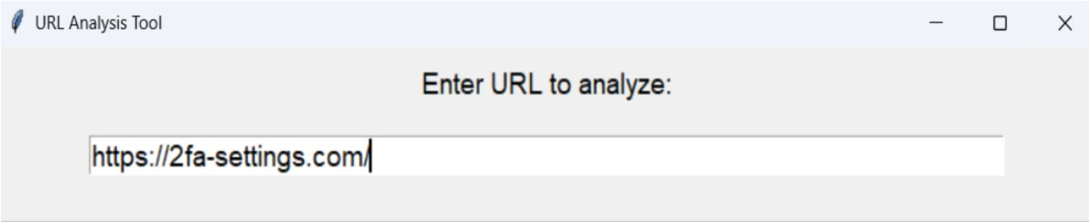
Methodology
The tool follows a structured approach:
User Input: The user enters a URL for analysis.
The tool verifies the format of the input and ensures it is a valid URL.

Slide 5
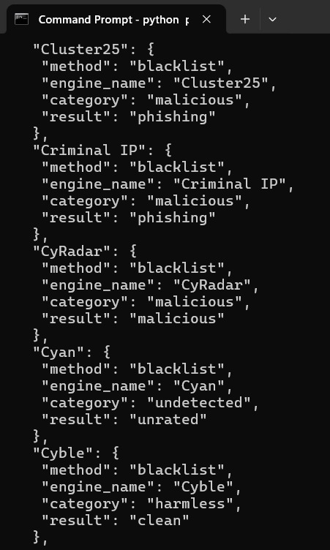
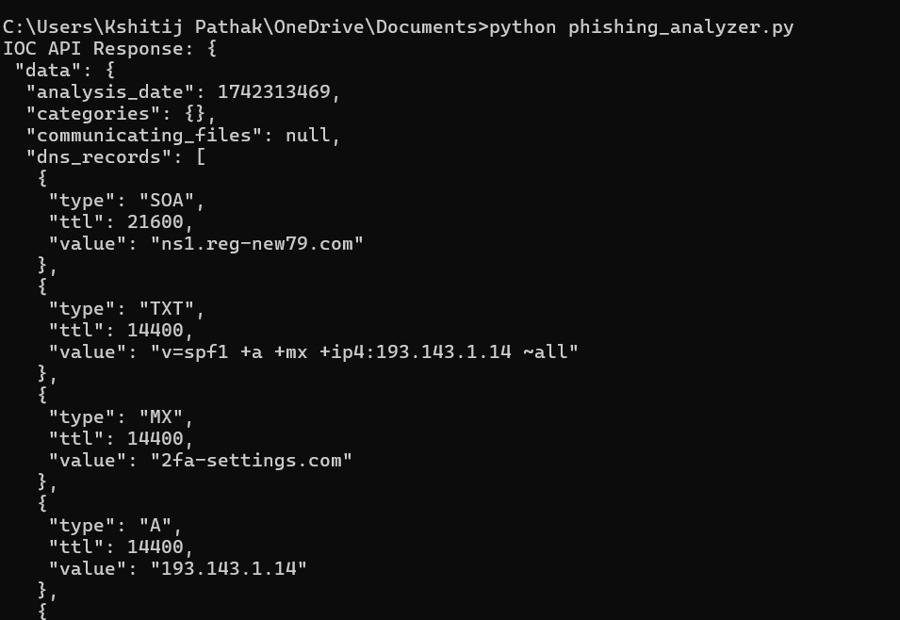
2. Threat Intelligence Checks: APIs such as Google Safe Browsing, VirusTotal, and IOC Search analyze the URL.
Google Safe Browsing checks for known phishing or malicious links.
VirusTotal scans against a vast database of reported threats.
IOC Search cross-references the URL with threat intelligence sources.

Slide 6
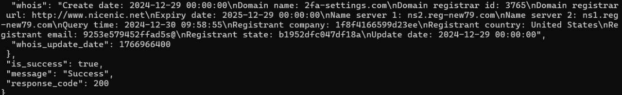
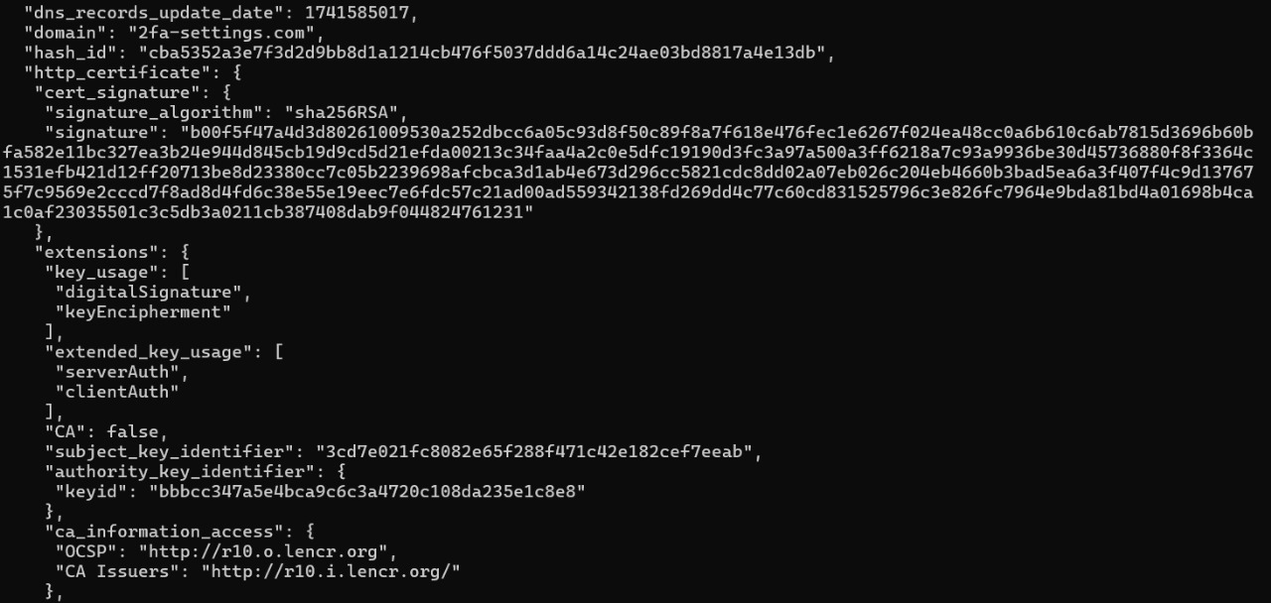
3. Domain & DNS Analysis: The tool extracts DNS records and resolves domain IPs.
The tool checks domain WHOIS records to retrieve owner information and domain age.
The DNS lookup helps verify if the domain is linked to known malicious IPs.

Slide 7
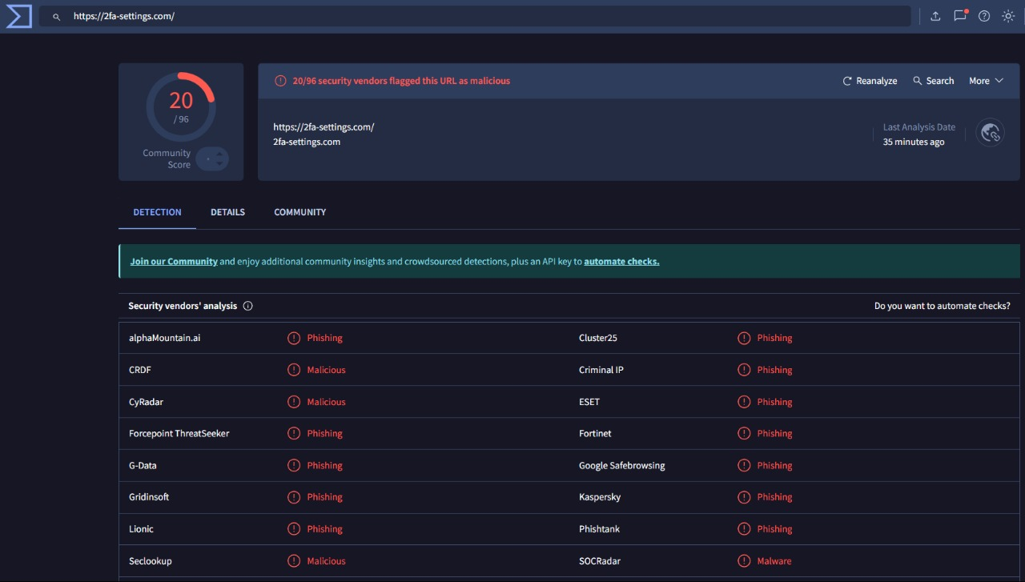
4. Verification of Flags: Cross-verification of flagged threats using multiple sources.
The tool consolidates reports from different APIs to validate if a URL is genuinely harmful or if it has false positives.

Slide 8
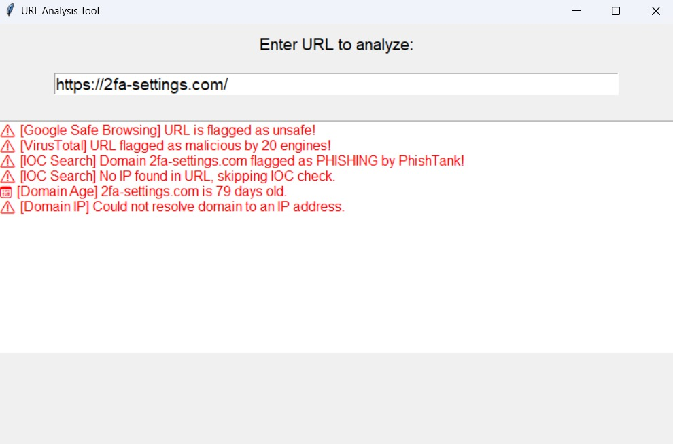
5. Output: The tool displays a detailed security report.
The final analysis includes risk scores, flagged reports, and recommendations for safe browsing.

Slide 9
Implementation
Programming Language: Python
Libraries Used: requests, whois, socket, tkinter
APIs Integrated:
Google Safe Browsing
VirusTotal
IOC Search
Graphical User Interface: Implemented using Tkinter for easy interaction.
Error Handling & Logging: The tool logs API failures, incorrect inputs, and analysis results for debugging and improvement.

Slide 10
Results & Observations
The tool effectively flags phishing and malware-hosting URLs.
It detects suspicious domain features such as short domain age and unusual DNS records.
The results provide actionable insights for cybersecurity assessments.
The GUI enhances usability, making it accessible to non-technical users.
Some flagged URLs required further verification, highlighting the need for cross-checking with multiple sources.

Slide 11
Conclusion
This project successfully implements a real-time URL threat analysis system, combining multiple threat intelligence sources to provide a comprehensive security assessment. By integrating APIs and domain analysis techniques, the tool ensures accurate and reliable detection of harmful URLs. The user-friendly interface enables individuals and security teams to assess URLs efficiently.
Future Enhancements:
Implementing machine learning to predict URL risks based on patterns.
Enhancing UI/UX with better visualization.
Expanding the database of flagged URLs for better detection.
Adding a browser extension for real-time URL verification.
Including sentiment analysis for identifying scam-based keywords in URLs.

Slide 12
References
Google Safe Browsing API: https://developers.google.com/safe-browsing
VirusTotal API: https://www.virustotal.com/gui/home/search
IOC Search: https://www.iocsearch.com/
WHOIS Lookup: https://who.is
URLVoid: https://www.urlvoid.com/

